Slide 1
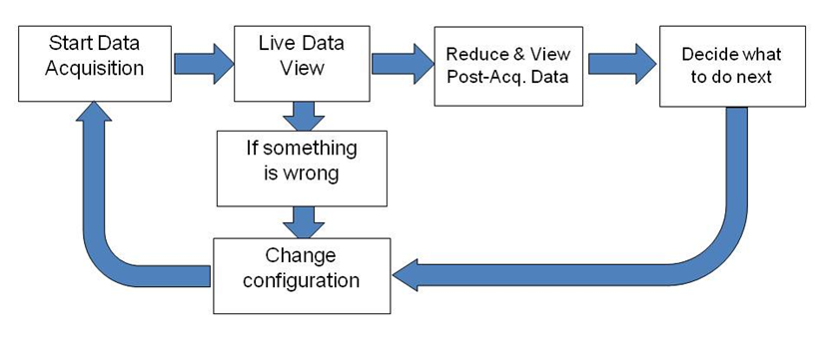
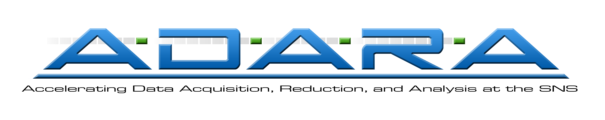
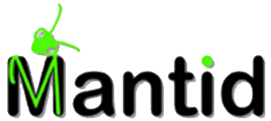
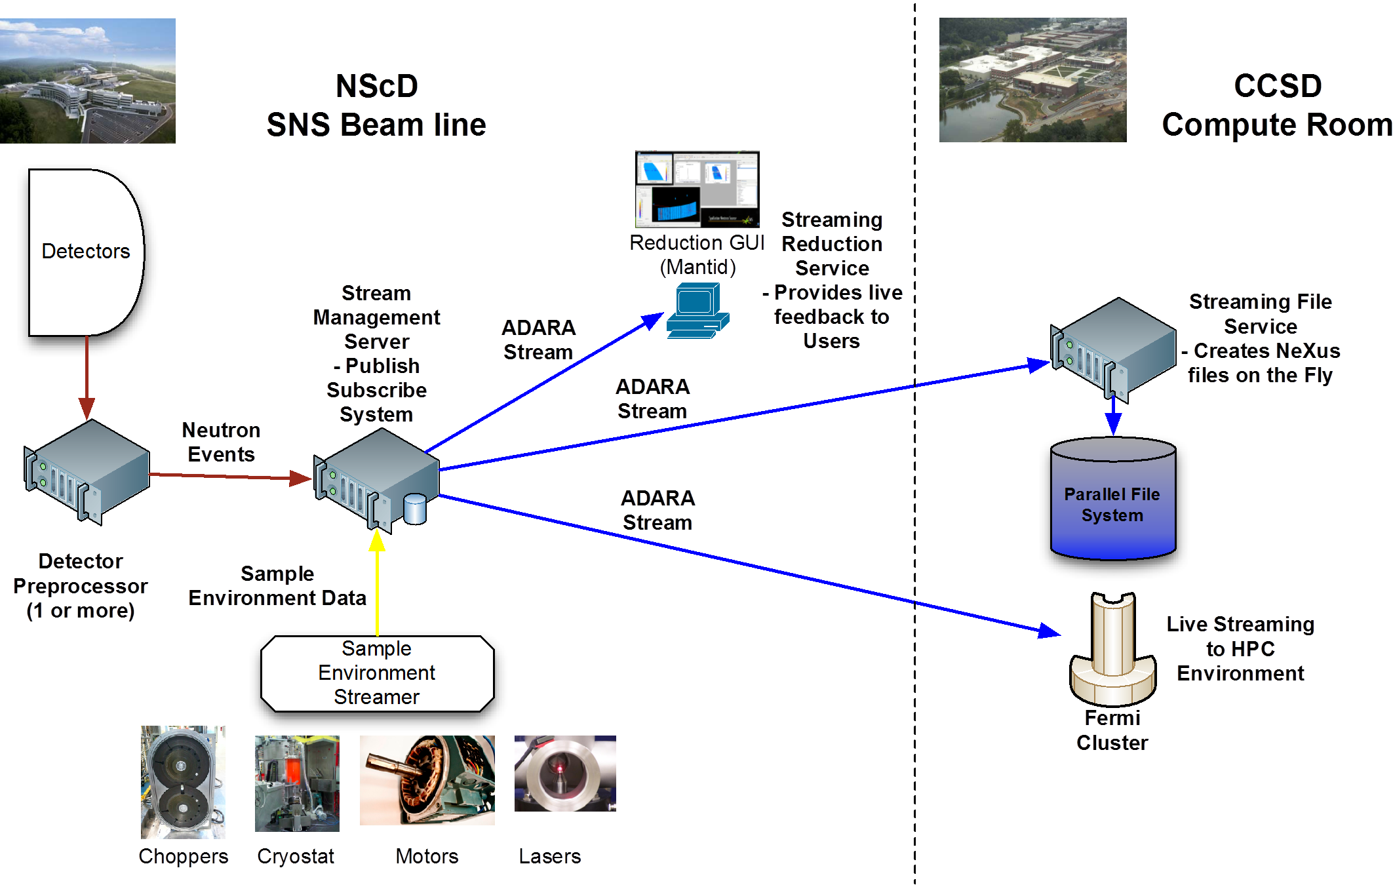
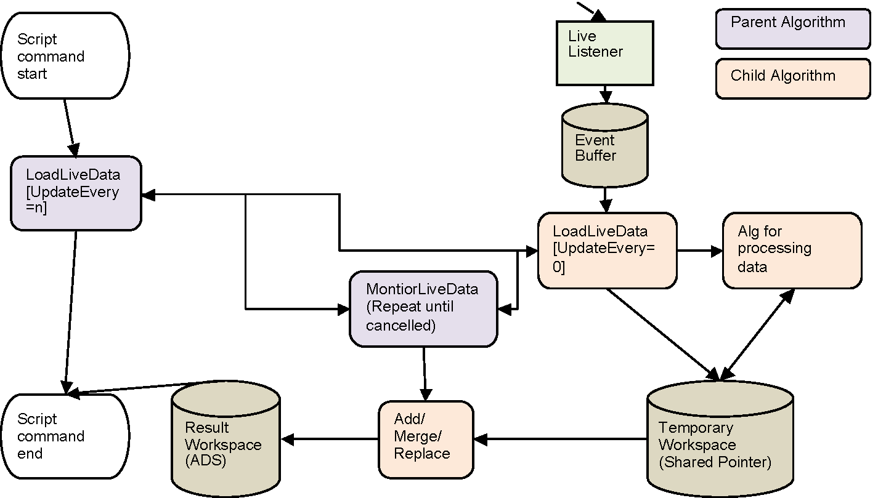
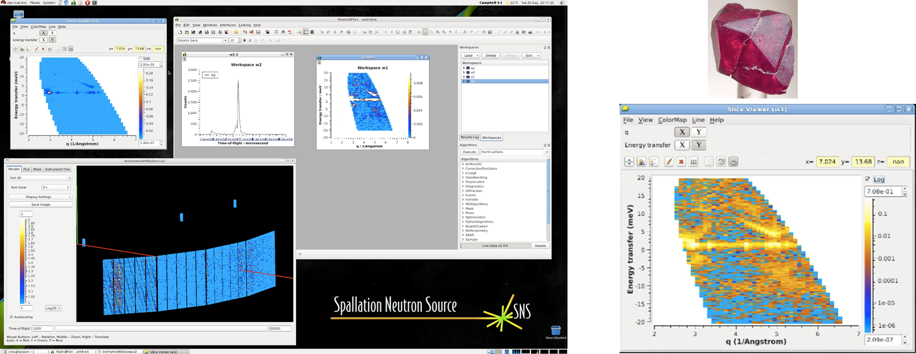
Streaming and processing of data in real time
Stuart Campbell, Nick Draper, Janik Zikovsky, Russell Taylor, Ross Miller
Motivation:
Data collected from experiment in the form of Neutron events
Position on detector and time of flight (TOF)
Up to 6 million events per second from a single beam line
The reduction and visualization, of some of the larger data sets can take hours after the data has been collected
Realizing the full potential of the SNS requires near real-time feedback to users as the experiment is run and integration of experiment and simulation/modeling
Design:
Accelerating Data Acquisition, Reduction, and Analysis at SNS = New architecture for data acquisition system
Built on existing foundations–the existing DAS system streams neutron data internally today
Use streams for neutron events, sample environment logs, choppers, etc.
Multiple listeners available for reduction/visualization, archiving, and analysis
Use TCP/UDP packets
Stream data (neutron and sample environment) from the DAS to a publish subscribe system Stream Management Service (SMS)
We modified MANTID (data reduction) to read from the data stream live from SMS Streaming Reduction Service (SRS)
Data translation (file creation) was re-configure the to read the data stream from SMS and create the files while the run is taking place… end of run = close file [file appears “instantly”] Streaming Translation Service (STS)
Files are created on an high performance computing infrastructure for subsequent parallel analysis and data reduction
Resources are directed towards analysis there and giving the users remote access
Run do not need to be saved before processing can begin, therefore users can look at live data. In order to efficiently process live event data it would be important to only process the events that have been added since the last call to the event buffer. The output can then be accumulated in a result dataset for display or further analysis. Benefits:
Control is returned to any script as soon as the first "chunk" of data has completed processing, allowing any graphs to be created in python.
The looping is controlled in only one algorithm, which can be cancelled by normal means.
Loading and the spawning of any processing is encapsulated in one algorithm.
Using Child algorithms and shared pointer workspaces will allow for memory to be cleared up as soon as it is no longer needed.
Results:
Full streaming architecture defined and documented in Q1 2012
Software development began in March, substantially completed by August
Completely new codebase using software engineering best practices
Full system demonstrated on the HYSPEC beamline on August 29th 2012
Cuprite (Cu₂O) sample using Inelastic Neutron Scattering
Calculated energy transfer live as the experiment was run (live-feedback)
Created NeXus files in real-time as the experiment was run
Positive remarks on ADARA and the strong partnership between CCSD and NScD from reviewers during the BES review closeout
Full ADARA system currently running on HYSPEC concurrent with the existing data system infrastructure
Provides a smooth transition to ADARA for subsequent beam lines
ORNL is managed by UT-Battelle, LLC, under contract
DE-AC05-00OR22725 for the U.S. Department of Energy.

